Slide 1
WCSD Payroll
Processing your Payroll
Through Timecard Online in BusinessPlus

Slide 2
WCSD Payroll Processing Procedures
WCSD payroll is processed for two separate cycles and calendars:
Certified payroll or Cycle 01 is run once a month
This includes Administrators, teachers, counselors
Classified payroll or Cycle 02 is run biweekly
This includes Education Support Personnel (ESPs)

Slide 3
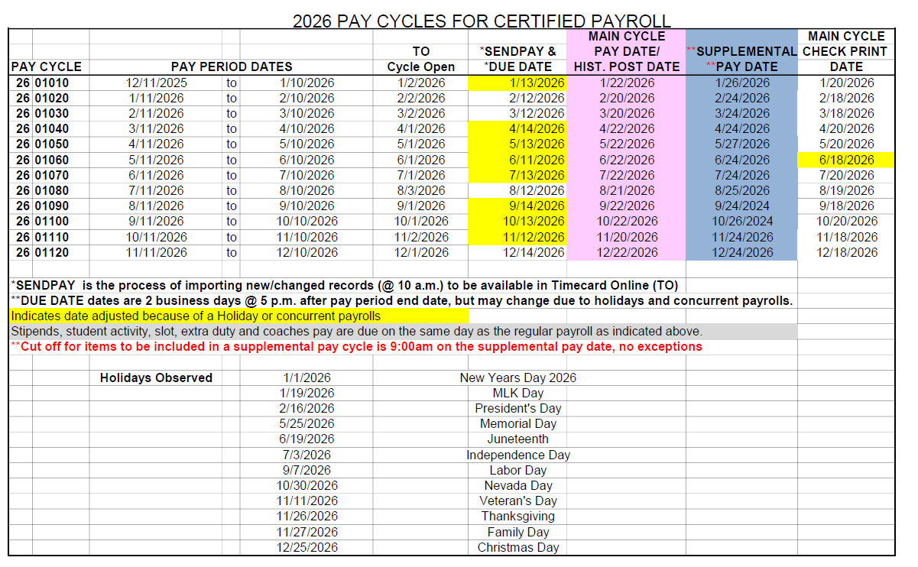
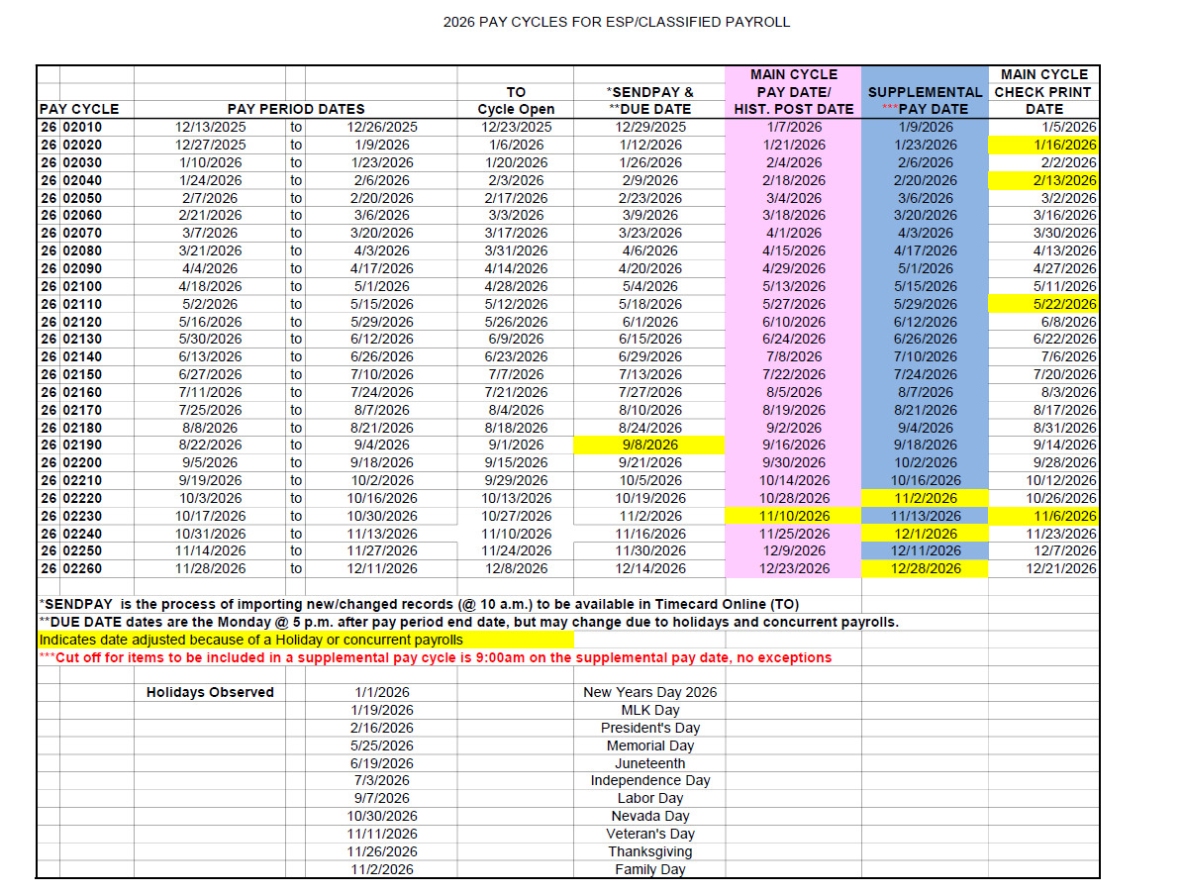
Pay Cycle Calendar List
PAY-L034,036: Certified Pay Cycles (A)
PAY-L045,046: Classified Pay Cycles (B)

Slide 4

Pay Cycle Calendar List
PAY CYCLE – the cycle number
PAY PERIOD DATES – begin and end work days
TO Cycle Open – the date we expect the cycle to be opened for Timecard Online entry
*SENDPAY & DUE DATE – the day Payroll pulls final records from HR and the day the payroll is due at 5 p.m.
MAIN CYCLE PAY/DATE – Pay day
SUPPLEMENTAL PAY DATE* – the day supplemental pay will be processed
Additional date related information including Holidays Observed is listed at the bottom of this listing

Slide 5
Site Payroll Processing Procedures
For accounting purposes, each site—whether a department or school—is assigned a responsibility center number or RC.
The majority of RCs are established as timekeeping groups that have a timekeeper and an approver.
The timekeeper enters time and exceptions to attendance for their site into Timecard Online.
Timecard Online is a part of the BusinessPlus software payroll function.
The approver reviews the data entered and “approves” the entries.
The approval step is necessary for the timekeeping to be accepted by the Payroll Department.

Slide 6
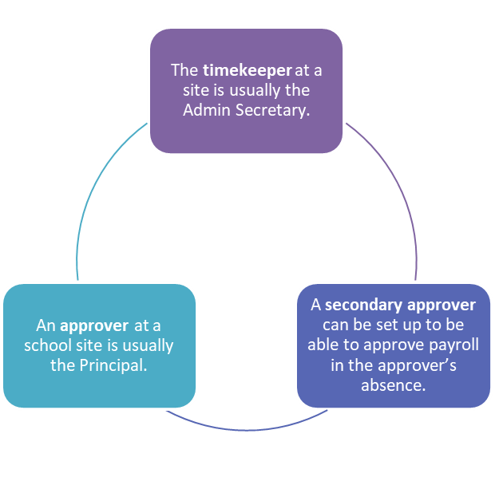
Payroll Processing Roles

Slide 7
Timekeeping & Approval Review Reports in Business Plus
DW1001 Payroll Transmittal – This report is run at the start of each timekeeping cycle to verify the list of employees that Payroll has on record for that cycle. Detailed instructions and guidance is at the top of the report. The signed copy is sent to Payroll by the due date.
TO1020B Supervisor Time Entry Report – This report is run during at several intervals of timekeeping to verify time entered and/or approval status complete,.
TO1025 Amended Supervisor Time Entry Report – This report is used to correct time entry from a previous cycle.
DW1065 WF (Workflow) Roles, Users, Timekeepers – This report lists employees assigned at your site to the timekeeper role as well as the approver role.
Notes:
There are a variety of reports that are used to complete and review the timekeeping and approval process. Below is a list of commonly used reports. Please see the Timekeeper Dashboard in BusinessPlus to run.

Slide 8
Associated Documents on WCSD Board Policy & Admin Regulations web page
PAY-L001 & PAY-L002 (C): Certified & Classified Hours Codes List for Timesheet Entry
PAY-L035,036 & PAY-L045,046: Certified & Classified Pay Cycles List for calendar year
PAY-L005 (D): Pay Class List
PAY-L010 & PAY-L011: Certified & Classified Time and Attendance Report (timesheet)
PAY-P502: Site Procedure for Processing OT/Additional Time and Comp Time
PAY-P505: Site Procedure for Records Retention
PAY-P504: Site Procedure for Flex Time Usage
Payroll Site Responsibility – sites listed by Payroll Tech – on Insight Secretaries Corner Payroll

Slide 9
Associated Documents
Memos: on Insight Secretaries Corner Payroll
Advisory: HR Work Hours Guidance-Education Support Professionals (Classified) Employees
Snow Day Memo
Effects Of Snow Days, Delayed Start & Facility Closures On Various Employee Work Hours, Pay And Leave Scenarios
Delayed Start And School Closure Procedures
Calendars & Work Schedules: on Human Resources web page
Negotiated Agreements: on Human Resources web page

Slide 10
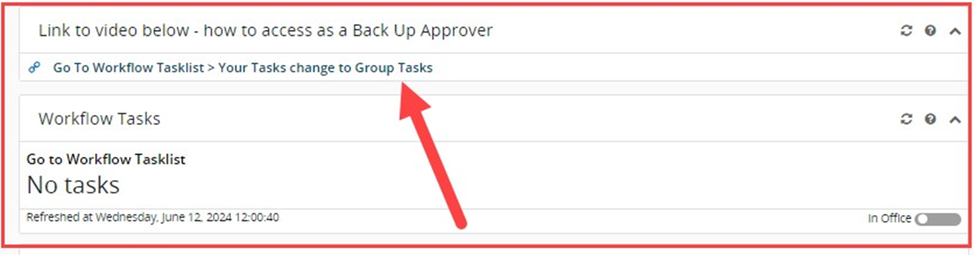
Other helpful tools for Administrators
Tutorials: BusinessPLUS and Business Processes
Job Aide:
Approval for Admins: Purchase Requests, Warehouse, Timecard Online
Videos:
Approvals for Admins: Purchase Requests, Warehouse, Timecard Online
Back-up Approver Workflow: Purchase Requests, Warehouse, Timecard Online

Slide 11
Discussion and Questions
How can we improve our communication and ultimately customer service?

